Slide 1
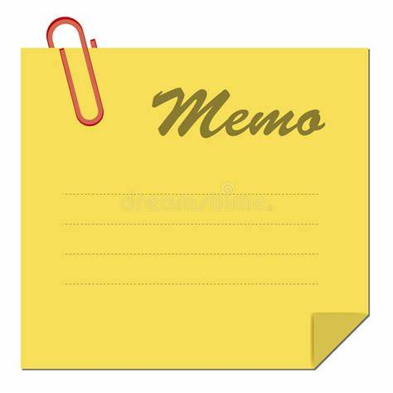
Memorandum

Slide 2
Memorandum is a short piece of writing generally used by the officers of an organization for communicating among themselves.
It is also called interoffice memorandum.
Its style is objective, factual and lucid.
No attempt is made to make an emotional appeal to the reader or to create a psychological impact on him.
It ensures quick and smooth flow of information in all directions.
It enables officers to maintain good business relationship as well as it helps to establish accountability.
The difference between memo and letter is that, Memos are circulated within the organization whereas letters are usually sent outside the organization.

Slide 3
Purpose of writing Memos
To explain something that has happened.
To arrange a meeting or invite someone for something.
To instruct someone of something.
To apologize for something you have done.
To ask someone about something.(for inquiries or request)
To report on the progress of a project.

Slide 4
Points to be noted while preparing memos
Memo deals only one subject at a time.
Impersonal style of language is used.
It must contain factual detail.
The heading should be written maintaining double space.
No salutation/ greeting, no complementary close.
Standard Memo format:
To:
From:
Date:
Subject:
Body:

Slide 5
Different components of memo
Reference no: generally placed on the top left hand corner of the page.
To- Recipient’s name/ designation
From- Sender’s name/designation
Date: submission date just below the sender’s name.
Topic or the subject: on which the memo is going to be written is normally placed just below the date.
The body: important part of the memo containing the message that the sender intends to convey. It must provide the details of the message. It depends on the purpose like requesting, informing, justifying etc.
Signature of the sender: placed at the left side at the bottom of the memorandum just below the ending of the body.
Cc: place to the left corner of the memo just below the signature of the sender.

Slide 6
Format of Memo
To: all students and staffs
From: principal(sometimes name and signature)
Date: 2o^{th} July, 2023
subject: To Attend Football Final Event
It is known that the students of National Academy of Science and Technology (NAST) have won the semifinal match and are going to play the final match. The final match is going to be held between KMC and NAST on 22 July 2023 in the sport ground of Dhangadhi, kailali. Hence all are requested to participate in the event as spectators in order to cheer and give moral support to the players.
Buses for the event depart at 2 pm on that very day.
……………..
Principal
Cc:
The administration section

Slide 7
Assignment
As a head of an organization you are worried about the amount of time employees are spending during the ' tea break'. Prepare a memo and circulate to all employees, asking them to be at their desk during duty hours.

